Slide 1
Measuring culture and culture’s effects
Psych 1a
Dr Eden Thain

Slide 2
Structure of the Module
Lecture 1
What is Cross Cultural Psychology?
Importance of Culture
Culture, Race, Ethnicity
Lecture 2
Multiculturalism
Multiculturalism, Race, and Identity
Cultural Competence
Cultural Adaptation
Lecture 3
Measuring the similarities and differences between Cultures and their effects
Therapy and Mental Illness
Lecture 4
Indigenous Psychology
Role of Psychologist working with Indigenous Australians
Lecture 5
Indigenous Research
Indigenous Research Ethics

Slide 3
What is Culture?
“Shared way of life of a group of people”
(Berry et al., 2011, p. 4)
“a system of inherited conceptions expressed in symbolic forms by means of which men [sic] communicate, perpetuate, and develop their knowledge about and attitudes toward life”
(Geertz, 1973)
the distinctive customs, values, beliefs, knowledge, art, and language of a society or a community. These values and concepts are passed on from generation to generation, and they are the basis for everyday behaviors and practices.
the characteristic attitudes and behaviors of a particular group within society, such as a profession, social class, or age group
APA Online Dictionary

Slide 4
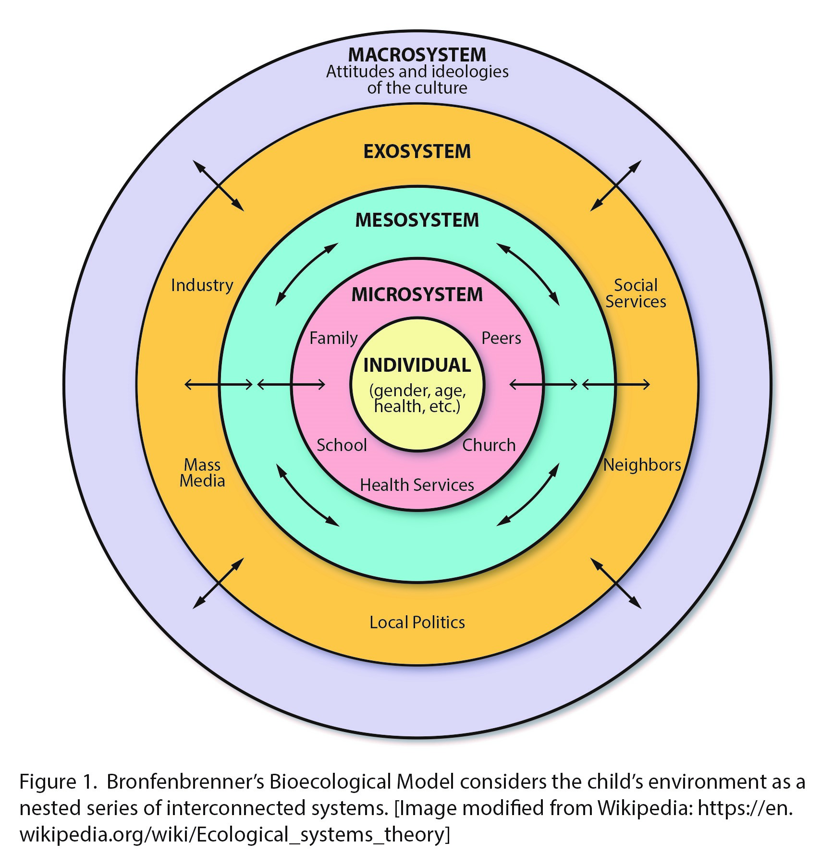
conceptualising culture By Context
Bronfenbrenner’s Ecological Model / Systems Theory
Microsystem
Direct contact and bidirectional influence
Mesosystem
Interaction between microsystems
Exosystem
The formal and informal social structure
Macrosystem
Larger culture (place and time)
(Chronosystem)
(Change over life time)
Bronfenbrenner (1977)
This Photo by Unknown Author is licensed under CC BY-NC

Slide 5
conceptualising culture By Values - Hofstede’s dimensions of culture
Individualist vs Collectivist
Power Distance
High Individualism = Independence; limited obligations
High Collectivism = Group Dependence; taken for granted obligations
High = Boss should be listened to because bosses are bosses
Low = Limited acceptance of power difference
Uncertainty Avoidance
Masculinity vs Femininity
High = stick to rules and traditions expecting similar outcomes
Low = allow unknown outcomes without rules to limit
Masc – Material focus, competition, achievement focused (Getting ahead)
Femme – People focus, cooperation, care focused (Staying together)
Long-term vs Short-term orientation
Indulgence vs Restraint
Short – traditional and focused on sustaining norms
Long – focused on change and development for future
Indulgence – Seek and facilitate desire fulfilment
Restraint – Limit and prohibit desire fulfilment

Slide 6
Theories and Conceptualisations of Culture
Hofstede’s Dimensions of Culture
Culture exists in comparison
Power Distance
Individualism vs Collectivism
Uncertainty avoidance
Masculinity vs Femininity
Long-term vs Short-term orientation
Indulgence vs Restraint
Limitations
Applied nationally / homogenising
Organisation / Business focus
Gender differences ignored
Masc / Femme Eurocentric and stereotyped in the worst way (feminine = poor performing countries)

Slide 7
Conceptualising Culture
Psychology has gone about understanding culture in many ways
As Values
As Context
As Caste
As Intergroup Relations
As Universally Adaptive Tools
As Capital
As Navigating and Negotiating Borders
For more on these see review by Cooper and Denner (1998)

Slide 8
Psychological Influence of Culture
Individual’s Behaviour and Thinking
What do you wear? What do you eat? What do you believe is valuable in life?
Social structures: Law, Government, Family, Religion, Language
What is just? Who is in-charge? Who do you live with? What do you believe? What can you say?
Material and Ecological: Place and Time
What is around you? What environments do you interact with? What is the Climate like? What technology can you use? What is the Industrial development of society? When and where will you be at different times of your life?
Mainstream psychology has a focus on Universalism (generalisation)

Slide 9
Examples of individual effects (psychology journals)
Cognitive Social Categories
Discursive use of groups
‘Cognitive Misers’ (Fiske, 1995) = Interpreting new information and making individual assessments about every new individual assessments about every new individual
Act as a guide to provide a general context about a person
Well-learned stereotypes are activated automatically
Application of stereotypes depends on factors of motivation (Matsumoto & Juang, 2008)
Discursive – how and why we produce language the way we do
Interested in how we establish groups and produce effects or ‘constructions’ of reality psychologically
Argues that all categorisation happens as this active process

Slide 10
Examples of effects
Bi- and multi- cultural identified people
Face unique challenges in society
Likely more common recently
Ethnocentrism
Ethnic group self-centeredness
In-group preference and superiority
Can have negative consequences
Racism and prejudice psych wellbeing
People have unreasonable and negative stereotypes
Strong associations between experiencing prejudice and racism and poor health
138 studies showing association between ill health and racism (even after adjusting for confounders) (Paradies, 2006)

Slide 11
Mental Health Impacts
Culturally Relevant Factors for Mental Health
Race-based cultural issues
Ethnic differences – disagreements
Gender expectations (and change)
Economic divisions
Castes and Classes
Cultural Capital and Power
Disorder differences
Can be used politically
New Perspectives on Disorders – Power Threat Meaning (Johnstone, & Boyle, 2018)
Social/Cultural Kindling hypothesis (Luhrmann, et al., 2015)
Long understood differences in disorder presentation (Kleinman, 1986)

Slide 12
Oppressive uses of psychopathology
Oppression of PoC – Punishing Civil Unrest
Homosexuality, & Trans Right (Gender Dysphoria)
Historically “mental illnesses” existed such as Drapetomania (Cartwright, 1851)
When a African slave escaped captivity
Southern State propaganda “too familiar and treating each other as equals”
The Protest Psychosis (Metzl, 2010)
1960s influx of African-American Psychosis diagnosis
Traced to a change of wording in DSM-II
Being “Hostile” or “Aggressive”
Both are part of structural and scientific racism
Homosexuality (Drescher, 2015)
Criminal and pathology since the 1800s
1973 removed from the DSM-III; 1990 removed from IDC
Lasting cultural effects but also a way forward with the change to support rather than treatment
Gender Dysphoria (Suess Schwend, 2020)
Still part of the DSM-5; moved in the IDC to “gender incongruence”
Still a long way to go in the understanding that it is not illness

Slide 13
Reflection
How do your understandings of culture (and sub-cultural groups) align with the conceptions of culture shown here?
What else do you need to know about culture academically to better explore these ideas and experiences?
What ramifications do you want your input to psychology to have on the political and personal experiences of people throughout time and the world?
Do you think any other things we currently pathologize will change as cultures change?

Slide 14
References
Bar-Tal, & Labin, D. (2001). The effect of a major event on stereotyping: terrorist attacks in Israel and Israeli adolescents’ perceptions of Palestinians, Jordanians and Arabs. European Journal of Social Psychology, 31(3), 265–280. https://doi.org/10.1002/ejsp.43
Bronfenbrenner, U. (1977). Toward an experimental ecology of human development. American psychologist, 32(7), 513.
Cooper, C. R., & Denner, J. (1998). Theories linking culture and psychology : Universal and community-specific processes. Annual Review of Psychology, 49(1), 559–584. https://doi.org/10.1146/annurev.psych.49.1.559
Cartwright, S. A. (1851). Report on the diseases and physical peculiarities of the Negro race. DeBow's Review. New Orleans
Drescher. (2015). Out of DSM: Depathologizing Homosexuality. Behavioral Sciences, 5(4), 565–575. https://doi.org/10.3390/bs5040565
Hofstede Insights. (2021). WHAT ABOUT AUSTRALIA? https://www.hofstede-insights.com/country/australia/
Kairuz, Casanelia, L. M., Bennett-Brook, K., Coombes, J., & Yadav, U. N. (2021). Impact of racism and discrimination on physical and mental health among Aboriginal and Torres Strait islander peoples living in Australia: a systematic scoping review. BMC Public Health, 21(1), 1–1302. https://doi.org/10.1186/s12889-021-11363-x
Metzl. (2010). The protest psychosis how schizophrenia became a black disease. Beacon Press.
Paradies,. Y. (2006). A systematic review of empirical research on self-reported racism and health. International Journal of Epidemiology, 35(4), 888–901. https://doi.org/10.1093/ije/dyl056
Pilecki, A., & Hammack, P. L. (2014). “Victims” Versus “Righteous Victims”: The Rhetorical Construction of Social Categories in Historical Dialogue Among Israeli and P alestinian Youth. Political Psychology, 35(6), 813-830.
Suess Schwend, A. (2020). Trans health care from a depathologization and human rights perspective. Public Health Reviews, 41(1), 3–3. https://doi.org/10.1186/s40985-020-0118-y

